Slide 1

Rescue-feet
Gesture Controlled Hexapod with Live stream for rescue operations
Team 8: Archit Sharma, Sai Pranay, Samyu Kamtam

Slide 2
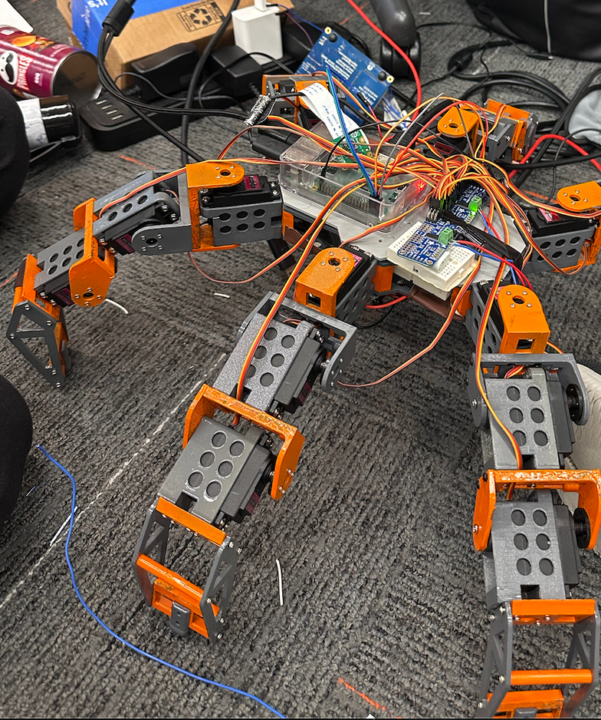
Project Overview
Six-legged (18 DOF) locomotion & biologically inspired gait
Gesture control for remote and convenient operation
Live stream for teleoperation

Slide 3


Advantages
Disadvantages
Enhanced mobility
Remote controlled operation
Stability and redundancy
Real time video streaming
User-friendly
Modular & scalable design
Complexity (Design and control)
Cost
Energy consumption
Connectivity issue
Payload limitations

Slide 4


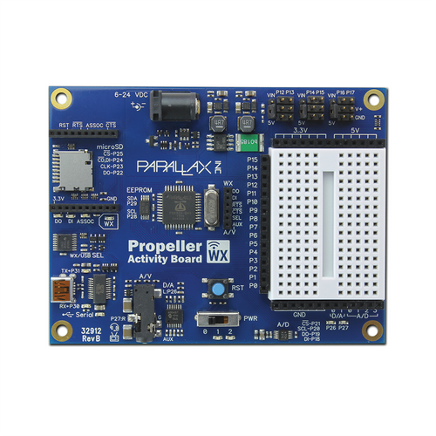
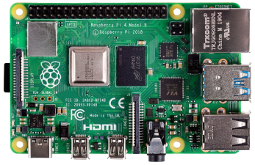


System architecture
Gesture control - Propeller
Hexapod
Gesture control for
navigation using flex sensor
and Memsic accelerometer
WiFi
Gait calculation for
servo control
Rasperry pi
Live stream
WiFi
Picam live video capture

Slide 5
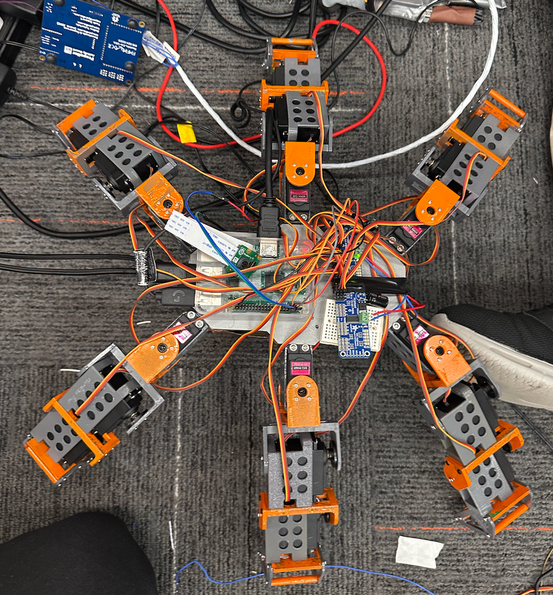
Hexapod
Servo: The servo motors receive PWM signals from the I2C-based driver to perform precise joint movements.
I2C: I2C communication connects the Raspberry Pi to the servo driver for synchronized multi-servo control.
Power distribution:
A buck converter steps down 8.3V to 6V to safely distribute power to all 18 servo motors.
The Raspberry Pi is powered by stepping down 8.3V to 5V using a buck converter to ensure stable and safe operation.

Slide 6
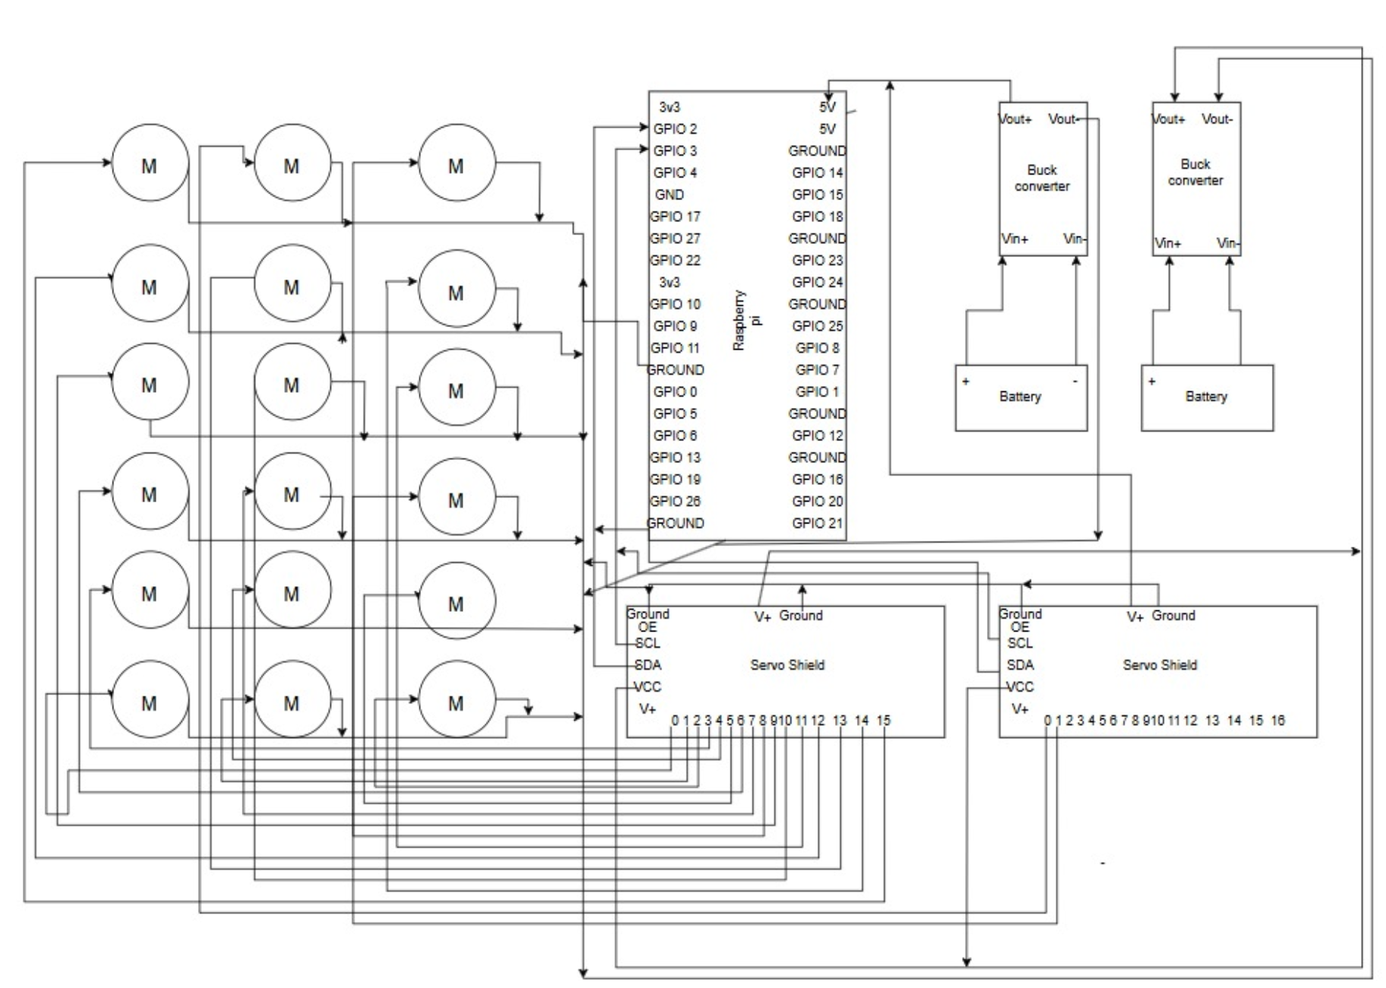
Hexapod circuit diagram
Rasperry Pi 3b
OS: Raspbian 64 bit
used for servo control and camera live stream

Slide 7
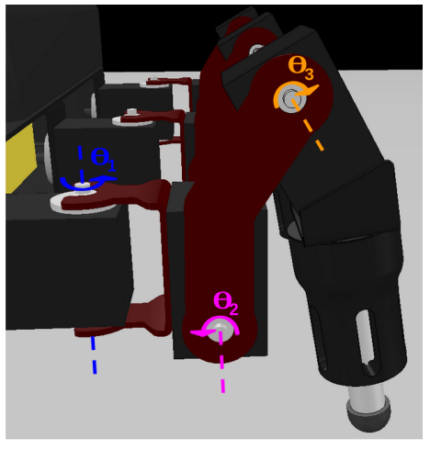
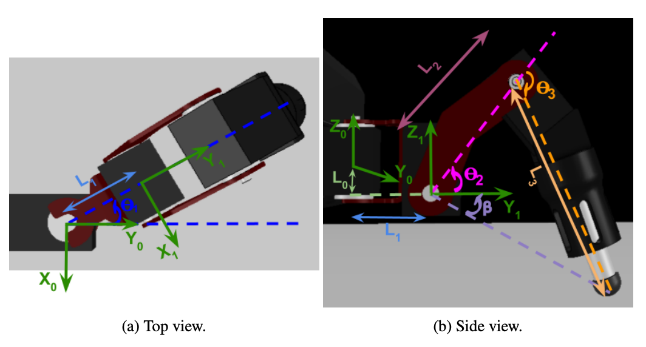
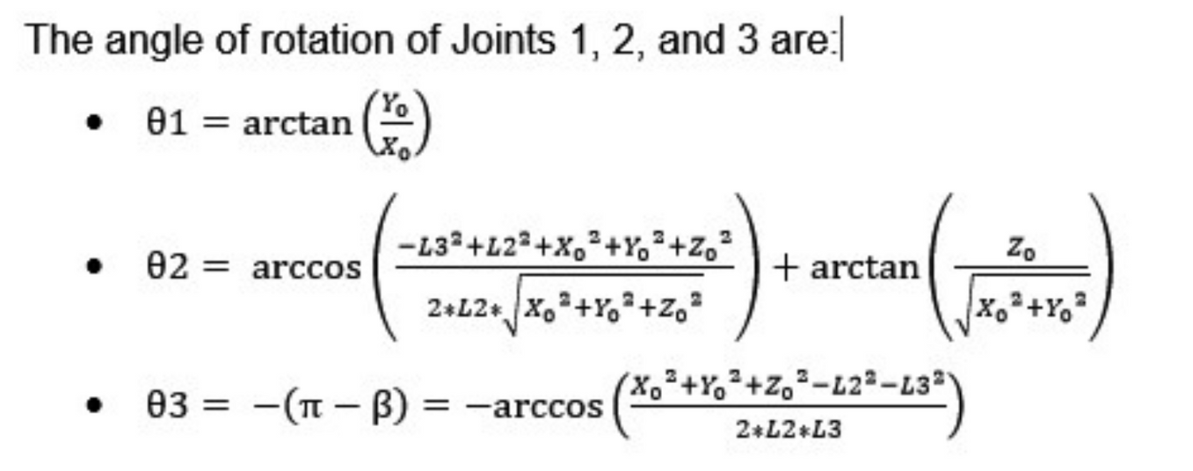
Kinematics

Slide 8
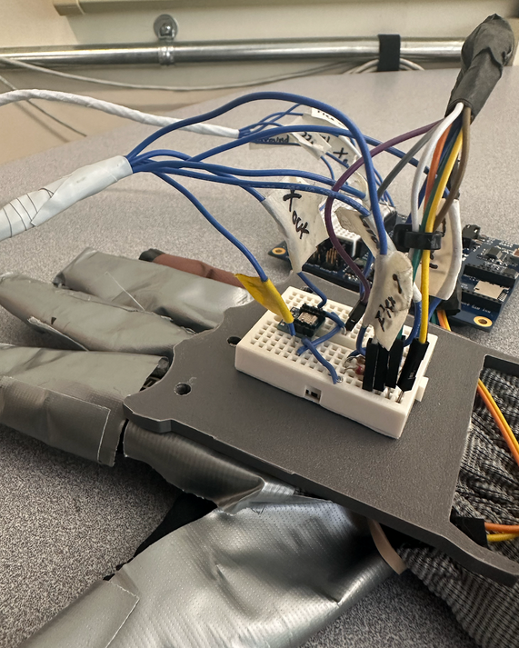
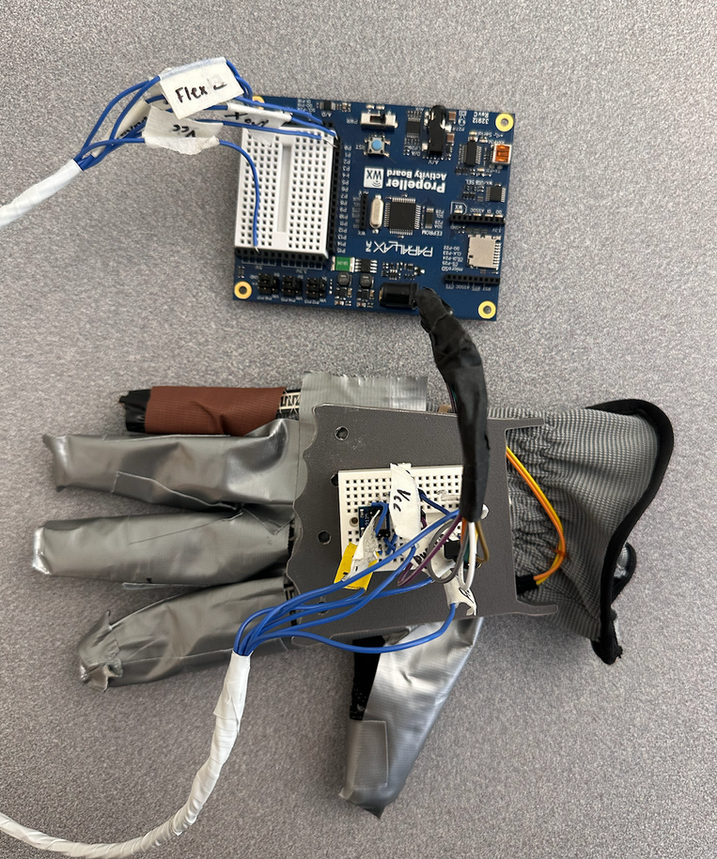
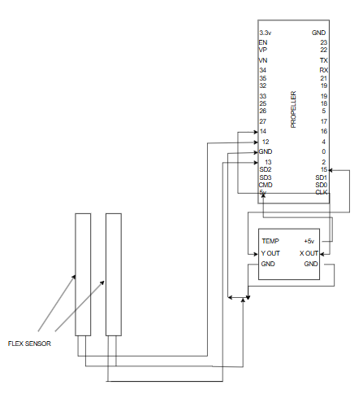
Gesture control
Cogs for Performance:
Multiple cogs on the Propeller read flex sensor and MX2125 accelerometer values while simultaneously encoding and transmitting data to the laptop.
Propeller Specs & Sensors:
8-core Parallax Propeller enables true parallel processing.
Each cog has 2KB RAM for fast local tasks.
Interfaced with MX2125 MEMS accelerometer and flex sensors for gesture input.

Slide 9
Encoder logic
State = flex1*18 + flex2*9 + x*3 + y
Movement | Flex 1 (*18) | Flex 2 (*9) | X (*3) | Y (*1) | Encoded value | Final value
Idle | 0 | 0 | 1 | 1 | 4 | 1
Front | 1 | 0 | 1 | 1 | 22 | 2
Front right | 1 | 0 | 0 | 1 | 19 | 3
Front left | 1 | 0 | 2 | 1 | 25 | 4
Back | 0 | 1 | 1 | 1 | 13 | 5
Back right | 0 | 1 | 0 | 1 | 10 | 6
Back left | 0 | 1 | 2 | 1 | 16 | 7
Bounce | 0 | 0 | 1 | 0 | 3 | 8
Kill | 1 | 1 | 1 | 1 | 31 | 9

Slide 10
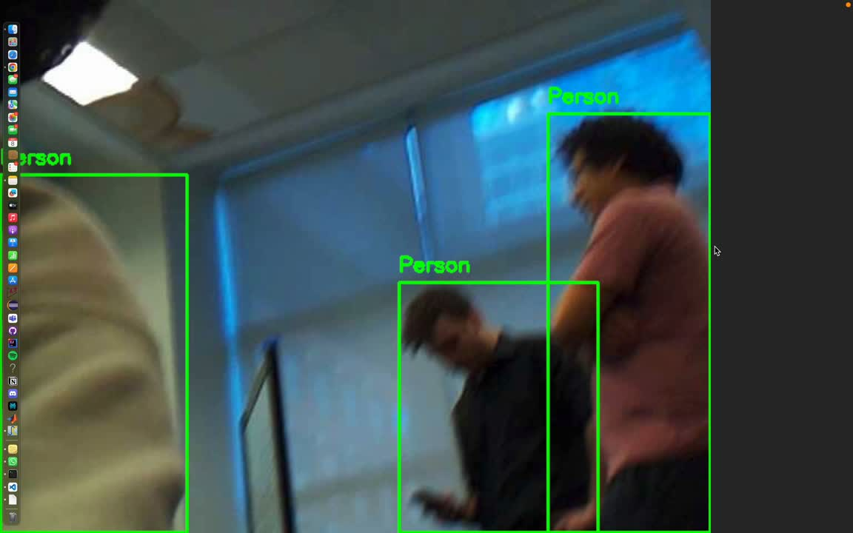
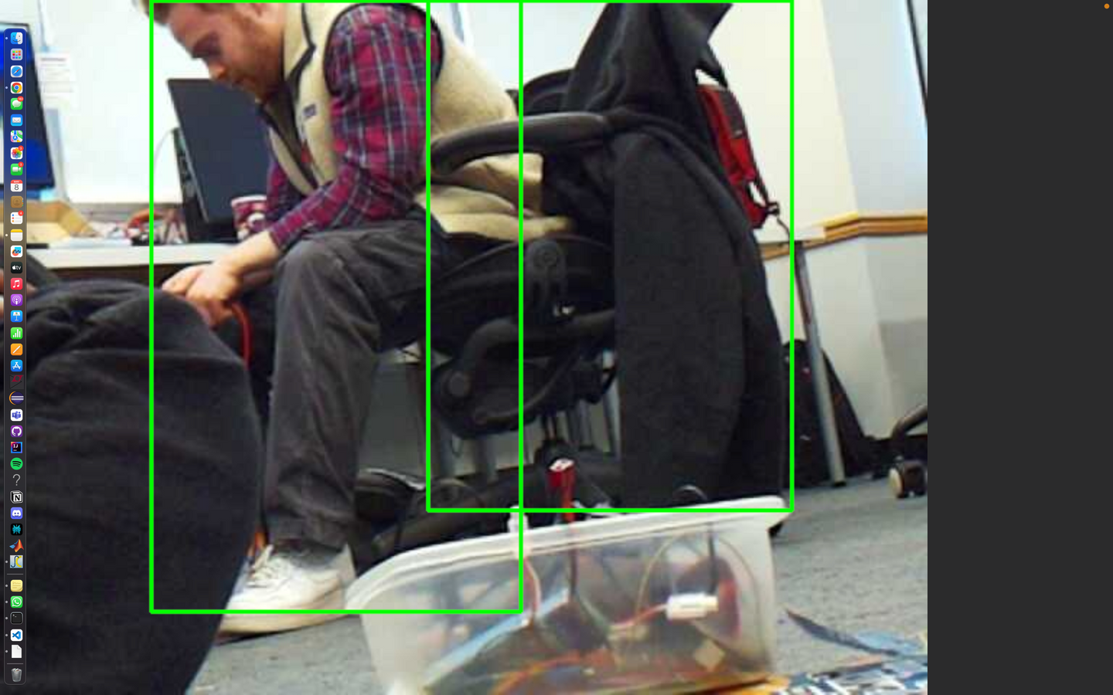
Live video stream
person
Basic object detection algorithm that decodes MJPEG that is streamed and displays the live video overlaid with detections using YOLO algorithm.

Slide 11
Conclusion
Revolutionize Search and Rescue operations
Enhances disaster response
Scalable
Has versatile applications
User centric design with gesture based control
Challenging with respect to system complexity and energy efficiency

Slide 12
Thank you
https://www.raspberrypi.com/documentation/computers/camera_software.html#advanced-rpicam-apps
https://www.youtube.com/watch?v=qs3KhLDUBmk
https://github.com/shillehbean/youtubep2/blob/main/stream_usb_camera.py
https://randomnerdtutorials.com/raspberry-pi-mjpeg-streaming-web-server-picamera2/

